Slide 1
Journey PPT 4

Slide 2
12-09-2023
Azure Synapse Analytics
Large scale data warehousing
Advanced analytics
Data exploration and discovery
Real time analytics
Data integration
Integrated analytics
Can work with any kind of data

Slide 3
12-09-2023
Features of Azure Synapse Analytics
Synapse SQL
Synapse Pipelines
Synapse Link
Synapse Studio
Synapse Spark

Slide 4
12-09-2023
Synapse SQL
Used to analyse data using sql tools like Serverless sql pool and Dedicated sql pool
Dedicated sql pool was formerly known as Azure sql datawarehouse
Synapse Spark
Used to work with multiple programming languages like R, Python, Scala
Synapse Link
Used to make communication with azure cosmos db. Uses HTAP(Hyper translational and analytical process)
Synapse Studio
It is the ide for synapse

Slide 5
12-09-2023
Synapse has default data lake storage.
All compute nodes have dedicated distributed storage
Data warehousing units have limit from dw100-dw30000
From dw100-dw500, it uses concept of scale up: Compute node -> 1, increased distributed storage
From dw1000 – dw30000, it uses the concept of scale out
DMS: Data movement service. Coordinates data movement among compute nodes.
Openrowset function is used to call data from external sources

Slide 6
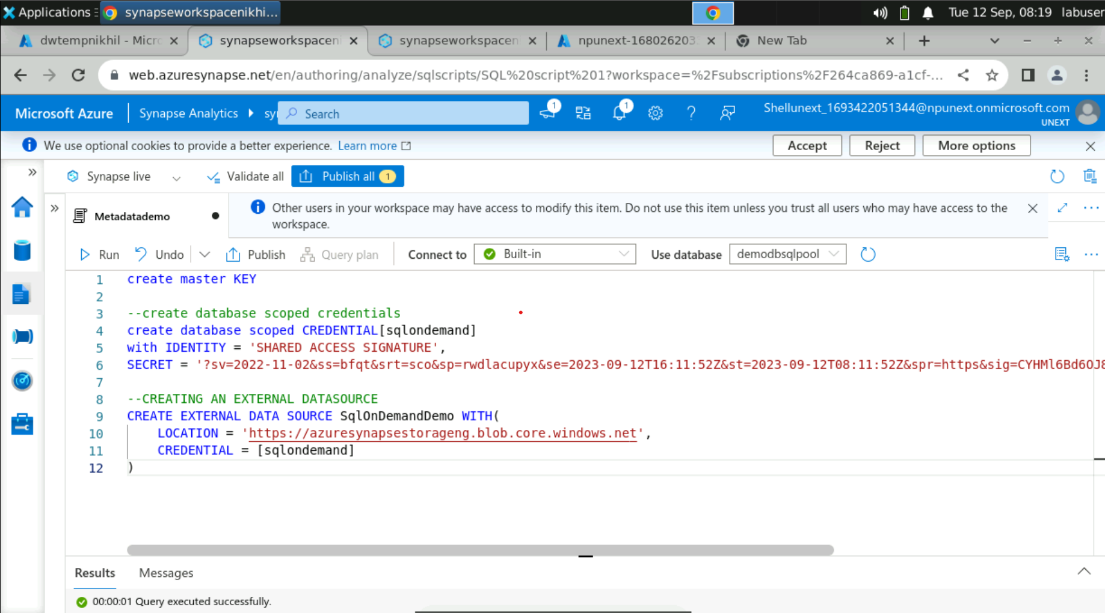

Slide 7
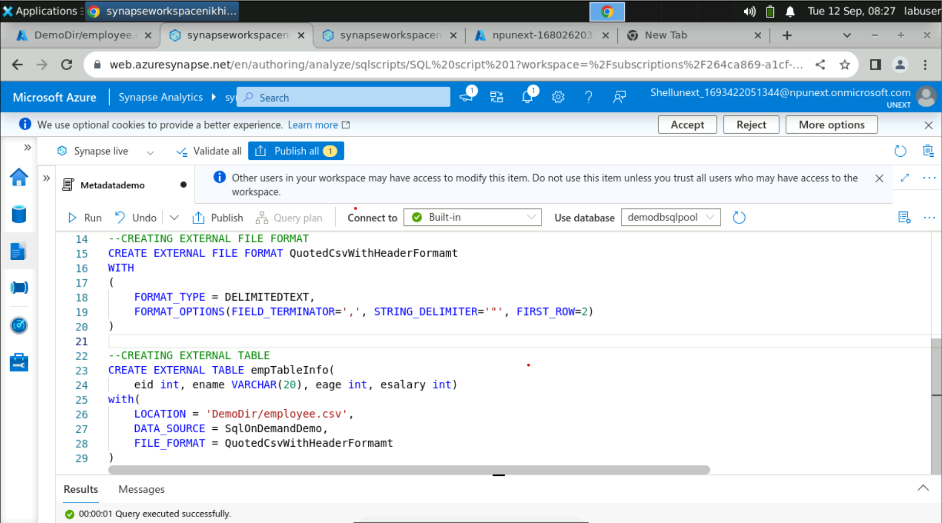

Slide 8
13-09-2023
Power BI
Collection of software, services, apps and connectors
Get data from flat files e.g. csv, excel
Get data from relational data sources e.g. SQL server
Get data from applications, analysis services, Microsoft Dataverse
Report View provides a canvas that we can use for our visual designs
In dataset view, we can explore our data to check the records.
In model view, we can create relationships, modify columns, tables

Slide 9
13-09-2023
Drill Down: Moving to next level like in a hierarchy
Drill Through: Move from one page to another
Row Level Security: Static RLS and Dynamic RLS
Static RLS: Manually give conditions
Dynamic RLS: userprincipalname() function is used

Slide 10
15-09-2023
Python
Used on a server for creating web applications
Used alongside software to create workflows
Can connect to database systems. It can also read and modify files
Can be used to handle big data and perform complex mathematics
Can be used for rapid prototyping or for production ready software development

Slide 11
15-09-2023
Why Python??
Works on different platforms
Syntax similar to English
Requires fewer lines than some other programming languages
Runs on an interpreter system. Can be executed as soon as it is written. Prototyping can be very quick
Can be treated in a procedural, object oriented and functional way

